Slide 1
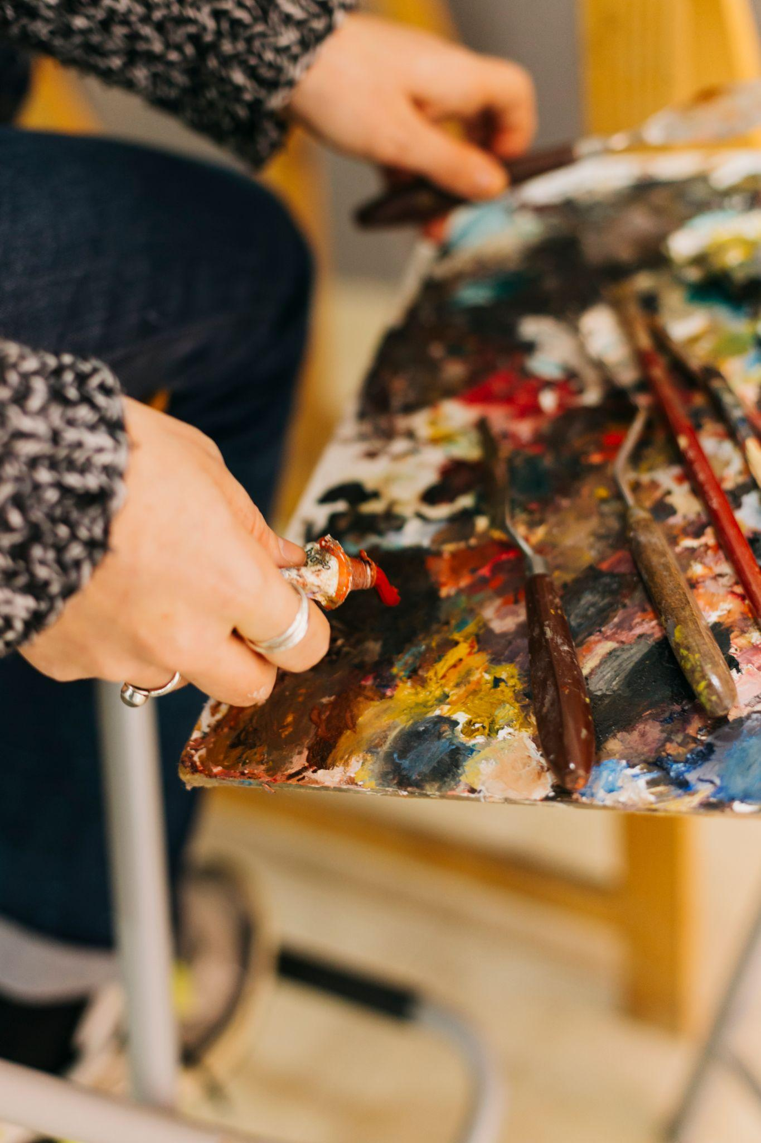
Learning Art
Need finding Report
Notes:
Hello, My name is David and my team’s Domain is Learning Art.

Slide 2
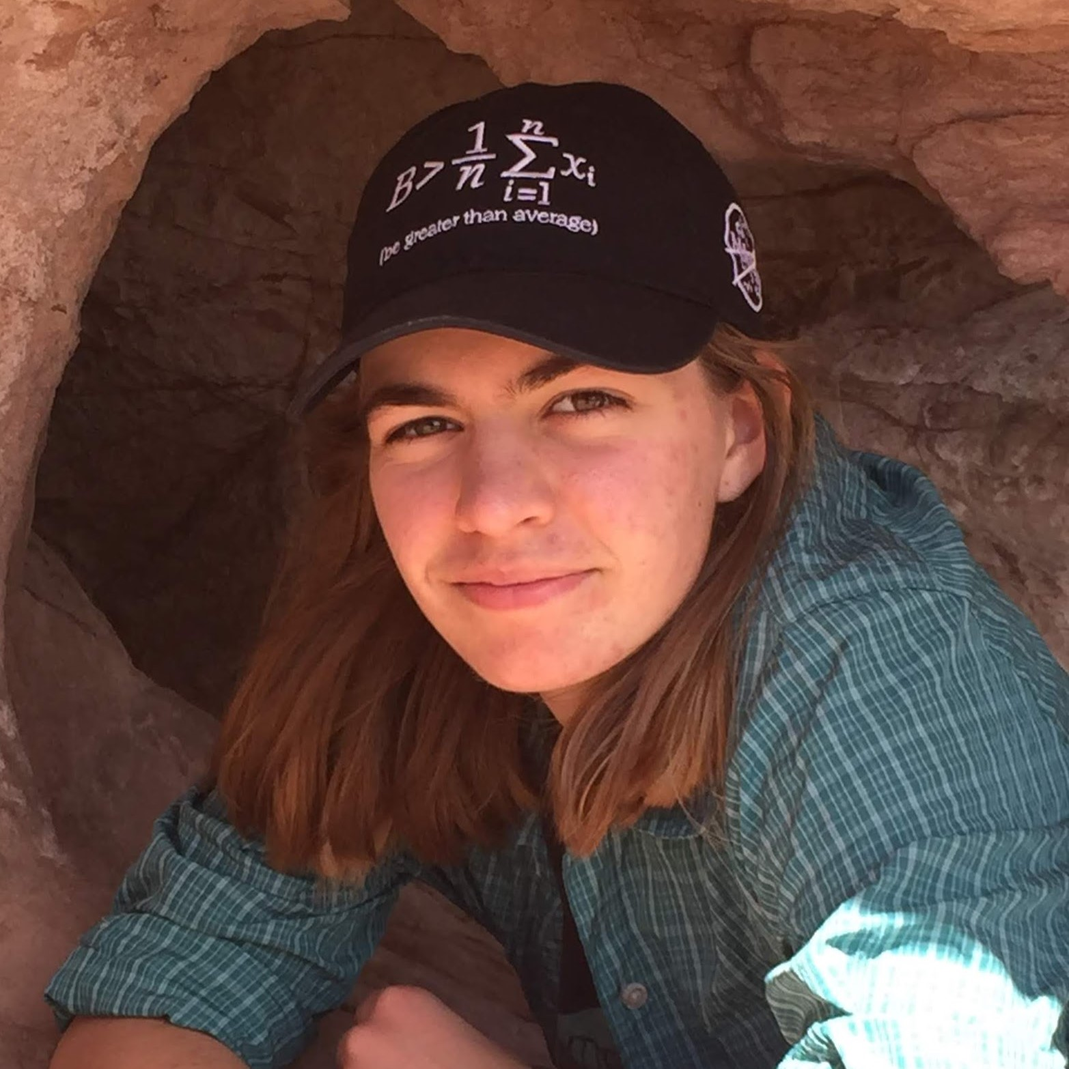
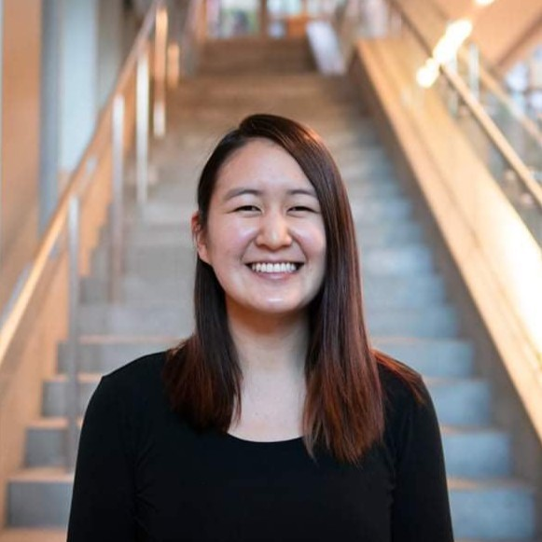
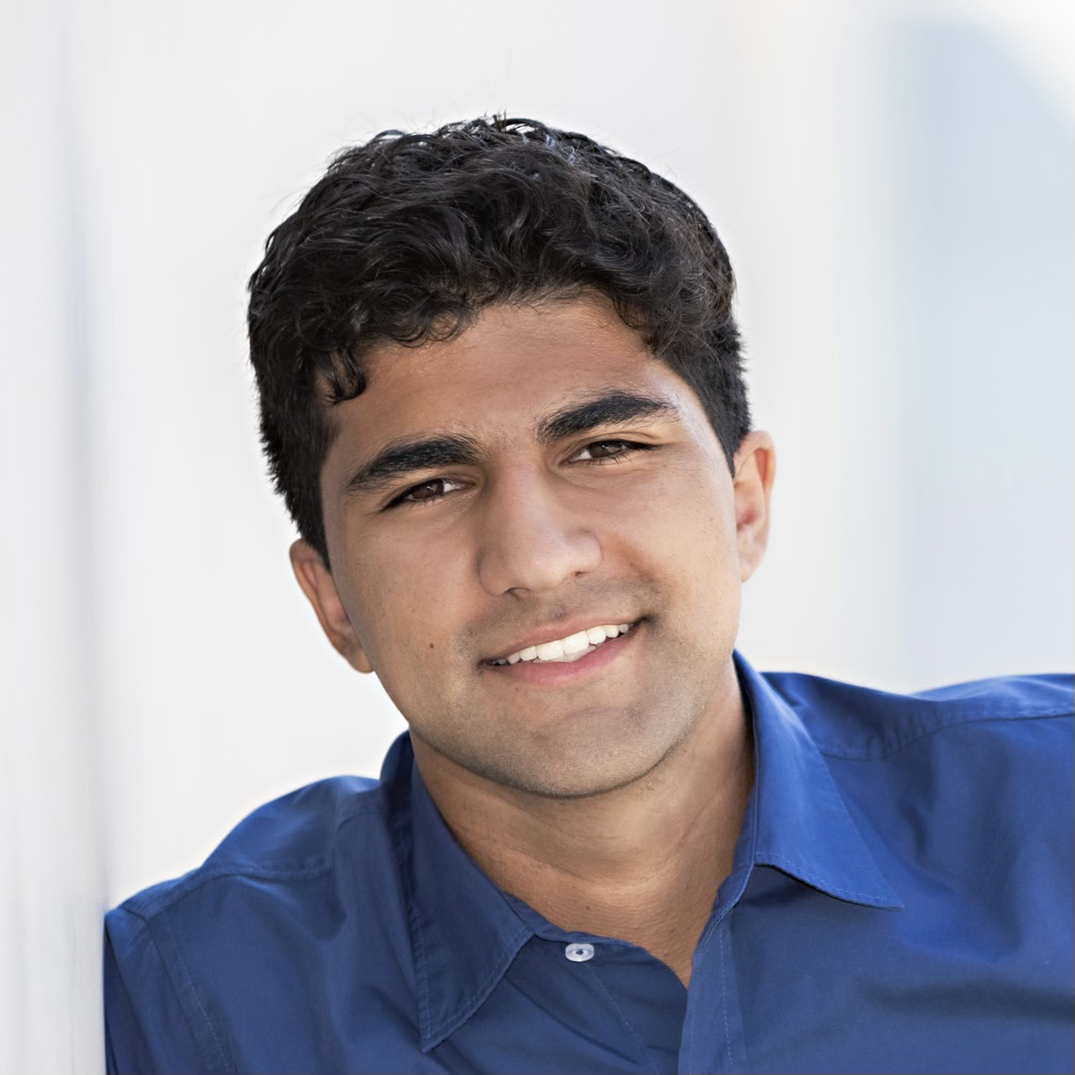
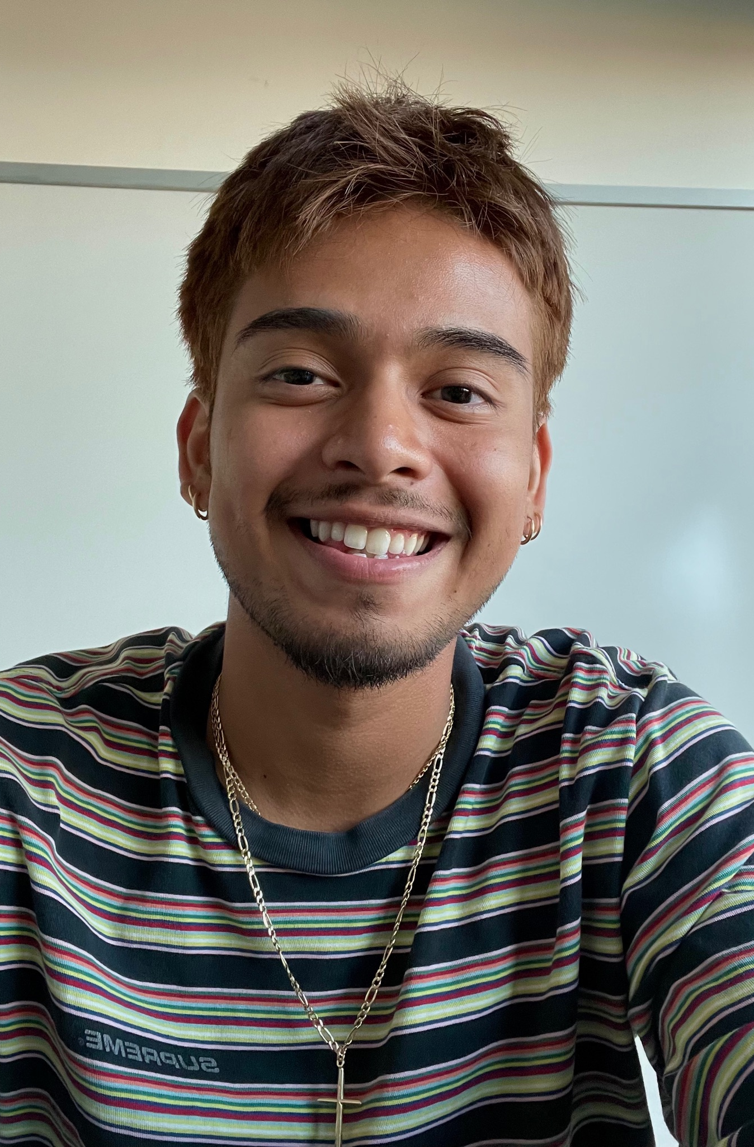
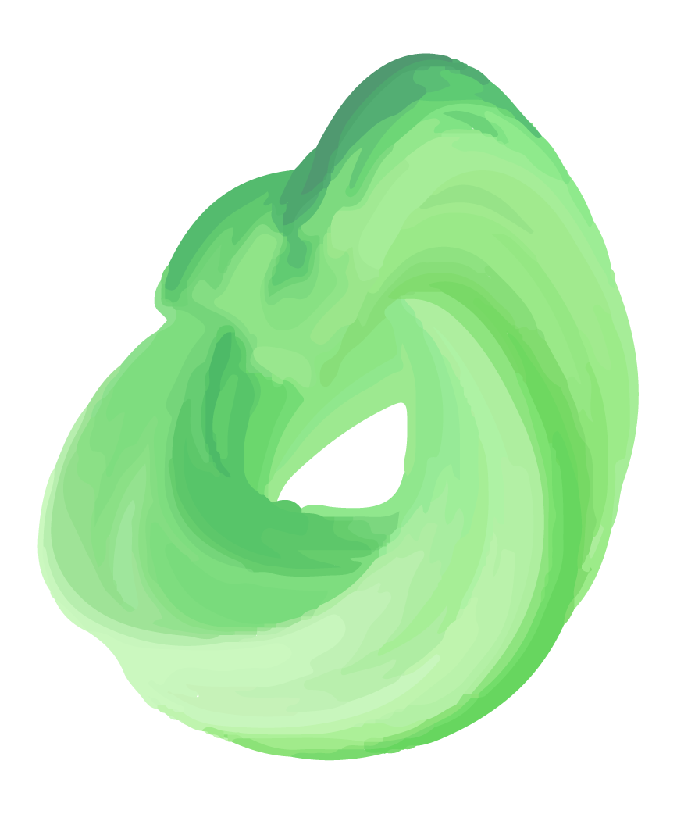
Meet the team
Becky Miller
Senior
Mechanical Engineering
Granville, OH
Marie Chu
Master’s student
Computer Science
Los Angeles, CA
Leyth Toubassy
Junior
Computer Science
Los Angeles, CA
David Castro
Junior
Symbolic Systems
Tacoma, WA
Notes:
Before, we proceed meet our team (introduce everyone)

Slide 3
Domain Selection
What are your hobbies?
What’s your experience with art?
Are we interested?
Notes:
We chose our domain by meeting and just getting know each other. We began by asking what our hobbies are and we went around sharing. Then, someone shared they enjoyed art. We started to share our experience with drawing. We had some leaning into this topic from everyone. And we chose this topic because it seemed relatable among our team and the general population. Mostly, everyone has had some experience with learning art.

Slide 4
Finding our Participants
Non-Stanford Students
Pushing ourselves beyond the Stanford Bubble
Diverse Art Experience
No experience? Artist? Some experience?
Art Mediums
Pottery, Music, Drawing, Other?
Notes:
Our methodology included seeking out non-stanford students as was required by the assignment. But other considerations included a diverse range of artistic ability. We took this into consideration because we wanted a variety of perspectives from people who would be extreme users, average users, or non users.
NOTES:
Participants were a mix of friends of friends and coworkers, someone from church
Interviews were conducted at Stanford/zoom
Finding users in their early twenties.
(out of high school, more formal education) We wanted to make sure we had one person who was really into art (extreme user).

Slide 5
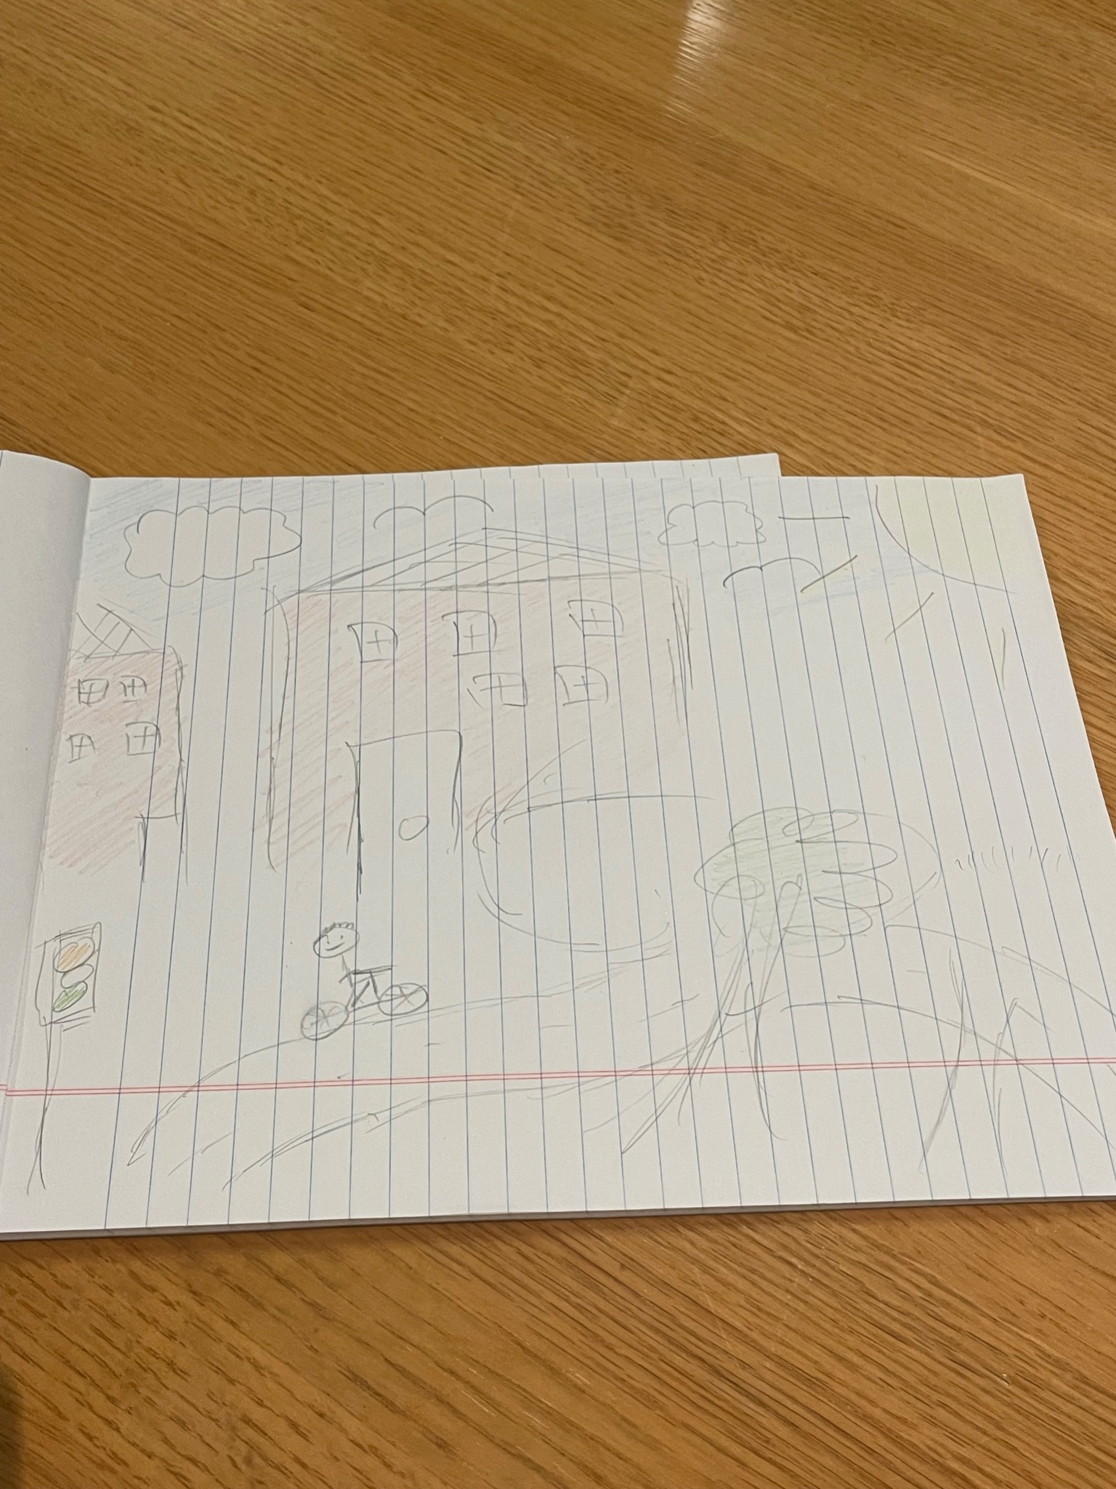
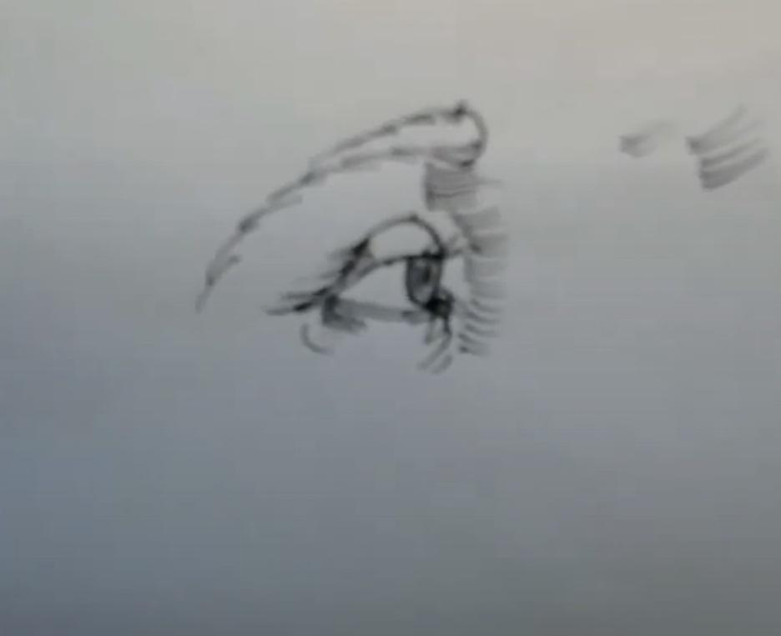
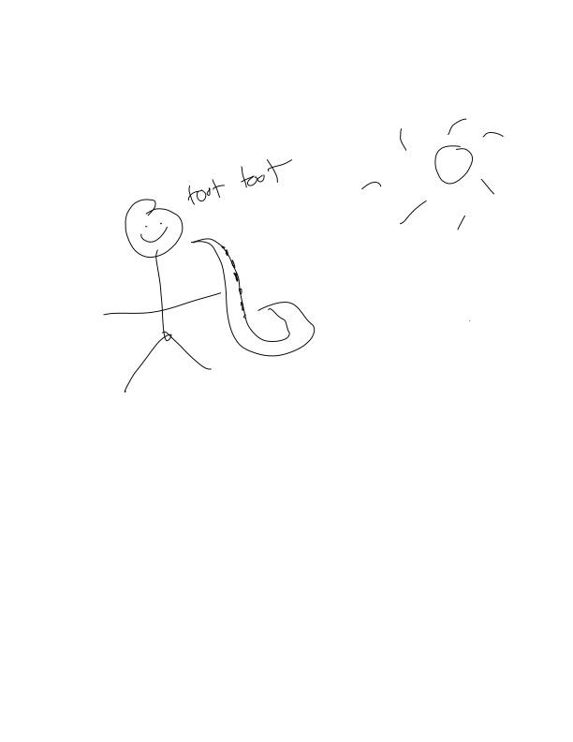
Meet Our Participants
Sean
20 years old
Seattle University
PM Intern @ Tesla
Olympia, WA
Justin
23 years old
UCSD alum
SWE @ Salesforce
Los Angeles, CA
Eric
24 years old
UCLA alum
SWE @ Meta
Bay Area
Notes:
Participants: Why were they chosen? Why are they appropriate? How were they recruited/compensated?
Where were the interviews conducted?
Who was your “extreme user”? In what axis are they extreme?
What did you ask?
Team member roles for each interview
Apparatus – any equipment/software used (transcribing, etc.)
Titus:
Art background: Took art classes in middle school w/ his brother. His family is pretty artsy however, doesn’t really prioritize art. (David interview / Leyth notetake)
Alex Lin:
Alex Lin was an extreme user as he picked up and rigorously studied art in his free time during the height of the pandemic. He still continues to learn alongside his full-time job. (Leyth interview / Marie notetake)
Alex Zhao:
Alex Zhao took art classes when he was younger but it never really stuck with him. He was always more into music and has converted that interest into playing rhythm games because consumption is easier than creation. (Becky interview / Marie Notetake)

Slide 6
Guiding Questions
What are some fond memories you have with art?
What are some Bad memories you have with art ?
How has you relationship with art changed over time?
If you’re telling a friend about your relationship with art how would you describe it?
What else is going on in your life that you think affects your relationship with art?
Could you show us some art you’ve done in the past?
Can you draw something for us?
Notes:
For each participant we first did introductions and asked about their background (i.e. occupation, where they are from, hobbies, etc.)
We then delve into their earliest memories of art and asked for any happiest memories, bad memories, etc.
The conversation evolved organically after that as we learned about their relationship with art and got to know our participants better.
We also asked them to share photos of their work and draw something for us if they were comfortable with it.

Slide 7
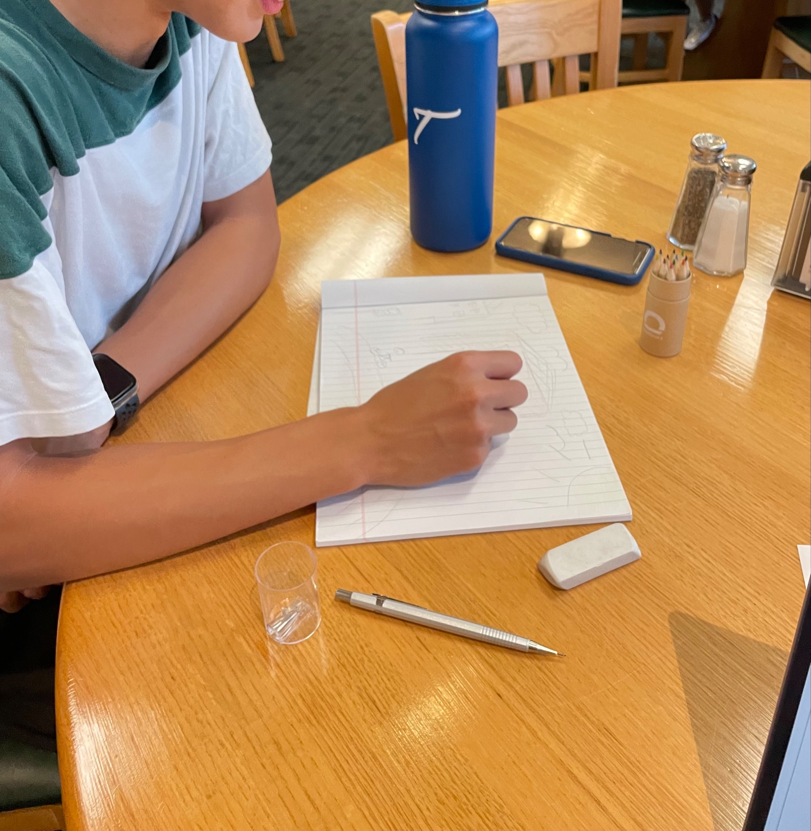
Sean, PM intern @ Tesla
“Art isn’t a priority”
“I suck at art”
“Making art socially is really fun!”
“I don’t have the patience for grindy video games”
“Why try when my mom, brother, and sister are so much better?”
Notes:
Titus Key findings: Somethings we found surprising about Titus were that he came from an artistic family however; he himself did not prioritize art and did not consider
Himself to be good at art.
We also found that he enjoyed learning art with others because he grew up taking art classes in middle school with his brother.

Slide 8
“Sucks at art”
Enjoyed art classes when younger
Enjoys doing art in social settings with others
Likes playing competitive video games
Very artsy family
Thought about taking art classes but not worth the money
Likes drawing symmetrical things like buildings, but not people
Things aren’t worth doing if he’ll do a bad job
More productive things should be prioritized
Starts with details because
doesn’t have patience to
start simple, wants to see results
SAY
THINK
TITUS GOH
FEEL
DO
Feels like he’s worse at art than those around him, so it’s not worth doing
Would rather spend free time in more
social ways
Needs some sense of
accomplishment in a hobby,
improvement not a big enough
motivator
Art not productive enough for
the “real” world
Told stories of himself failing with grace, laughter, and a smile on his face
Frowned when talking about his family being better than him at art
Wanted a prompt for the drawing we asked him to make
Genuinely reflected and started to see things like graphs and slide decks as forms of art
Notes:
Diving a little more deeper we have his empathy map. Some important things to highlight are that his attitude of feeling like he sucked at art. Led us to believe/infer that he views art as a waste of time. He would much rather use his time for something else. Another thing we saw was that he mentioned art classes were not worth the money in college which led us to believe he doesn’t view art as something productive in the real world.

Slide 9
Insights & Needs
Don’t want to waste time doing boring learning, when there are things one can do for instant fun.
The act of learning needs to be more engaging in and of itself
Some people need a more social component to making art
The artistic process needs more opportunities for people to be proud of their work before it’s done.
Art is very isolating, when instead could be playing games with friends.
Lack of progress leads to impatience and a lack of fulfillment
Notes:
Highlight the last one

Slide 10
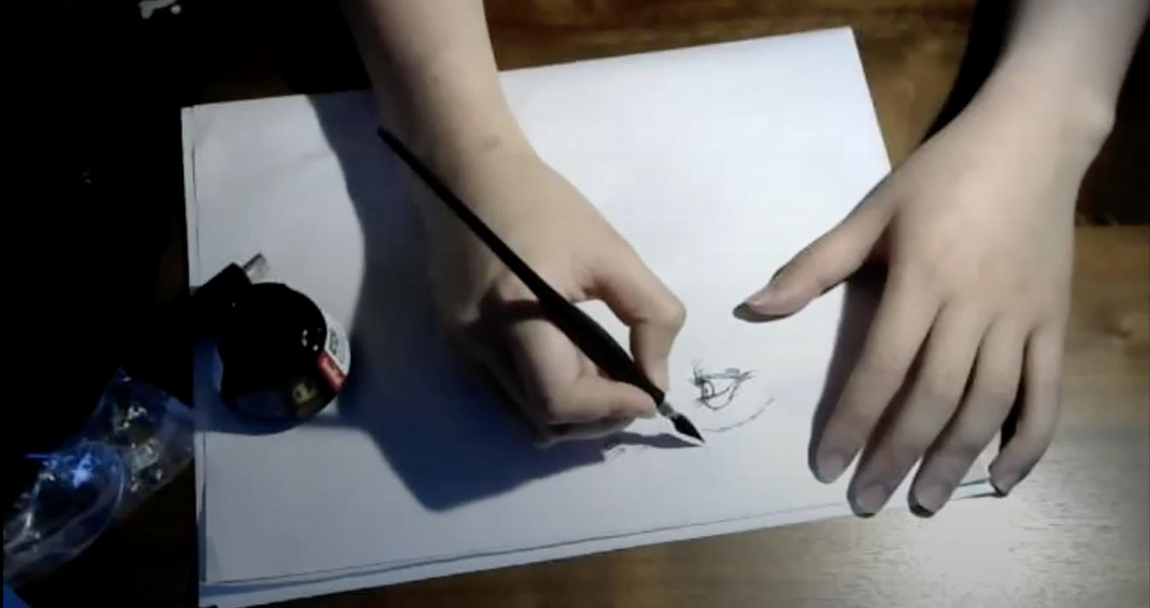
Justin, SWE @ Salesforce
“Without the pandemic I wouldn’t have started art”
“I started decorating fish tanks after my girlfriend got into fishes and dragged me into it”
“There’s too many resources online for art that I didn’t know where to start”
Notes:
Contradiction: He mentioned the most important thing about art school isn’t the content but the community and structure. → He’s taking online art classes but opts out of communicating with his peers because he has no time and would rather be drawing.

Slide 11
Took an intro art class in undergrad but dropped it
Art first priority, everything else becomes second
Probably wouldn’t have picked up art if there was no pandemic
Enrolled in online art classes while working full time
If he started art earlier it might’ve changed his career
Art is not suitable for career change
Art requires a lot of diligence
to improve in
His art skills still have a lot
of room for improvement
SAY
THINK
ALEX LIN
DO
FEEL
Didn’t even have to get up and get materials to sketch for us
Doesn’t show much emotion
Did not smile or seem excited when talking about a piece he was proud of
Immediately knew what he was going to draw
Appreciative of pandemic
Frustrated that most people
can’t make a living from art
Proud he stuck with art for
a long time
Confident in his drawing ability
Optimistic towards his
future in art
Notes:
Going further, we have Lin’s empathy map. I think the most important things to highlight here are: art is his priority and he enrolled in online art classes while working full time. He was also frustrated that you can’t male a living from art which is why he doesn’t think it’s a suitable career change.
I think another thing worth noting was that despite being consider good at art he believes there is still more room for improvement.

Slide 12
Insights & Needs
Too many resources that it’s hard to figure out where to start
Is a patient person but not patient when it comes to art
Enjoys art and considered it professionally
Condense, credible resources for beginners
Some way to prevent himself from working too long on a piece and getting frustrated
Be able to make a living from art and keeping his artistic freedom
Notes:
Some needs we kind of nice was be able to make a living from art. Lin also mentioned that there were too many resources that it’s difficult to see which ones are legit.
So our need would be to condense, credible resources for beginners.

Slide 13
Eric, SWE @ Meta
“Playing piano satisfies the itch”
“It feels good to see progress”
“I never really figured out brushes”
Notes:
Contradictions:
Said he didn’t feel pressure to draw well, but apologised for drawing poorly
Proud of things he worked hard on, but enjoys art forms that are easier for him
Complained about drawing/painting being too hard, but says rhythm games are hard for him and he spends a lot of time doing those, and enjoys them

Slide 14
lack of pride in drawings that are copied or created with help
music scratches the artistic “itch”
sometimes he feels like he should do art
feels good to see progress
isn’t as good at drawing as at music
he is competitive
music is more important to
him than visual arts
“good” art has greater value
creating original work is better
collaboration or help devalues work
a base level of skill is required
to enjoy and progress in art
learning a new art form isn’t
worth it without community
SAY
THINK
ALEX ZHAO
fidgeting with pencil
erased and restarted sketch multiple times
struggled to decide what to draw
paused to think about “why” questions
shared video of marching band
talked about lack of skill throughout sketching
FEEL
DO
comradery with artistic community
“itch” to use the “non-engineer side”
of his brain
proud of quality products
nervous about drawing
embarrassed by lack of skill
agitated under time pressure
Notes:
Continuing we have his empathy. The key things here are he feels good to see progress. learning a new art form isn’t worth it without community.
He felt more proud of original works. And when asked to draw he thought that he felt nervous and embarrassed by the lack of skill.

Slide 15
Insights & Needs
early learning curve for drawing and painting is steep and dissatisfying
emphasized signs of progress
support through early stages of learning
aids to creating quality work that don’t feel like “cheating”
competition and community motivate him to continue despite lack of perceived skill
a certain level of competency and product quality makes art more satisfying
Notes:
He mentioned a lot of things that talked about the different points in learning art, .We saw needs in emphasizing and support in different stages. But also being able to feel proud of your work.

Slide 16
Putting it all together
Some find the process of learning art to be boring/unfulfilling.
Some people are satisfied with improvement while others need to be “objectively” good to enjoy art
Large learning curves and huge time commitments deter people from trying
A supportive community is valuable

Slide 17
Next Steps
Conduct interviews with more diverse backgrounds instead of just art experience (i.e. gender, non-CS, etc.)
POV Development
Notes:
Have a lead w/ young art teacher in bay area for next week

Slide 18
THANK YOU!!

Slide 19
Feedback
Financial & time resources
Contradictions about community
What does art mean to them?
How do you make art fun?
Intrigued by possibilities for diversifying interviewees
Nice slides :) x2
Interesting “do” insights
Good presentation flow

